Slide 1

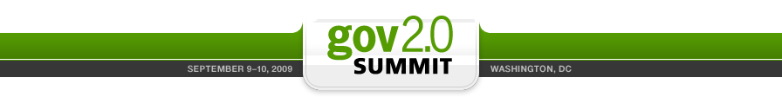
The Lean Startup
Doing More With Less
Government 2.0 Edition
Eric Ries
http://StartupLessonsLearned.blogspot.com

Slide 2
Most Startups Fail
Notes:
Hi, I’m Eric Ries. I wan to talk to you today about one simple fact: that the vast majority of high-tech startups fail.
It does not have to be that way.
Read the stories of successful startups and, if the founders are willing to be honest, you will see this pattern over and over again. They started out as digital cash for PDAs, but evolved into online payments for eBay. They started building BASIC interpreters, but evolved into the world's largest operating systems monopoly. They were shocked to discover their online games company was actually a photo-sharing site.
Each of these companies were fortunate to have enough time, resources, and patience to endure the multiple iterations it took to find a successful product and market. The premise of the lean startup is simple: if we can reduce the time between these major iterations, we can increase the odds of success.

Slide 3
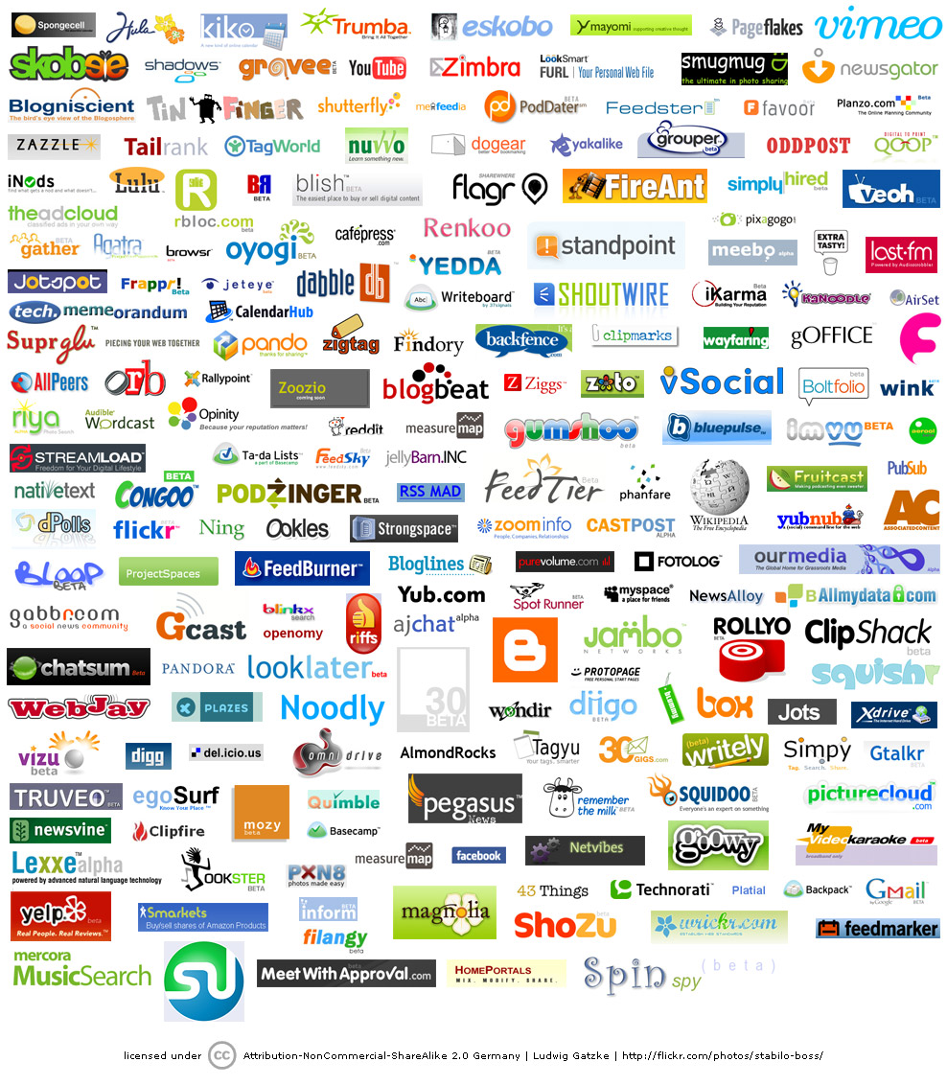
Most Startups Fail
Notes:
Hi, I’m Eric Ries. I wan to talk to you today about one simple fact: that the vast majority of high-tech startups fail.
It does not have to be that way.
Read the stories of successful startups and, if the founders are willing to be honest, you will see this pattern over and over again. They started out as digital cash for PDAs, but evolved into online payments for eBay. They started building BASIC interpreters, but evolved into the world's largest operating systems monopoly. They were shocked to discover their online games company was actually a photo-sharing site.
Each of these companies were fortunate to have enough time, resources, and patience to endure the multiple iterations it took to find a successful product and market. The premise of the lean startup is simple: if we can reduce the time between these major iterations, we can increase the odds of success.

Slide 4
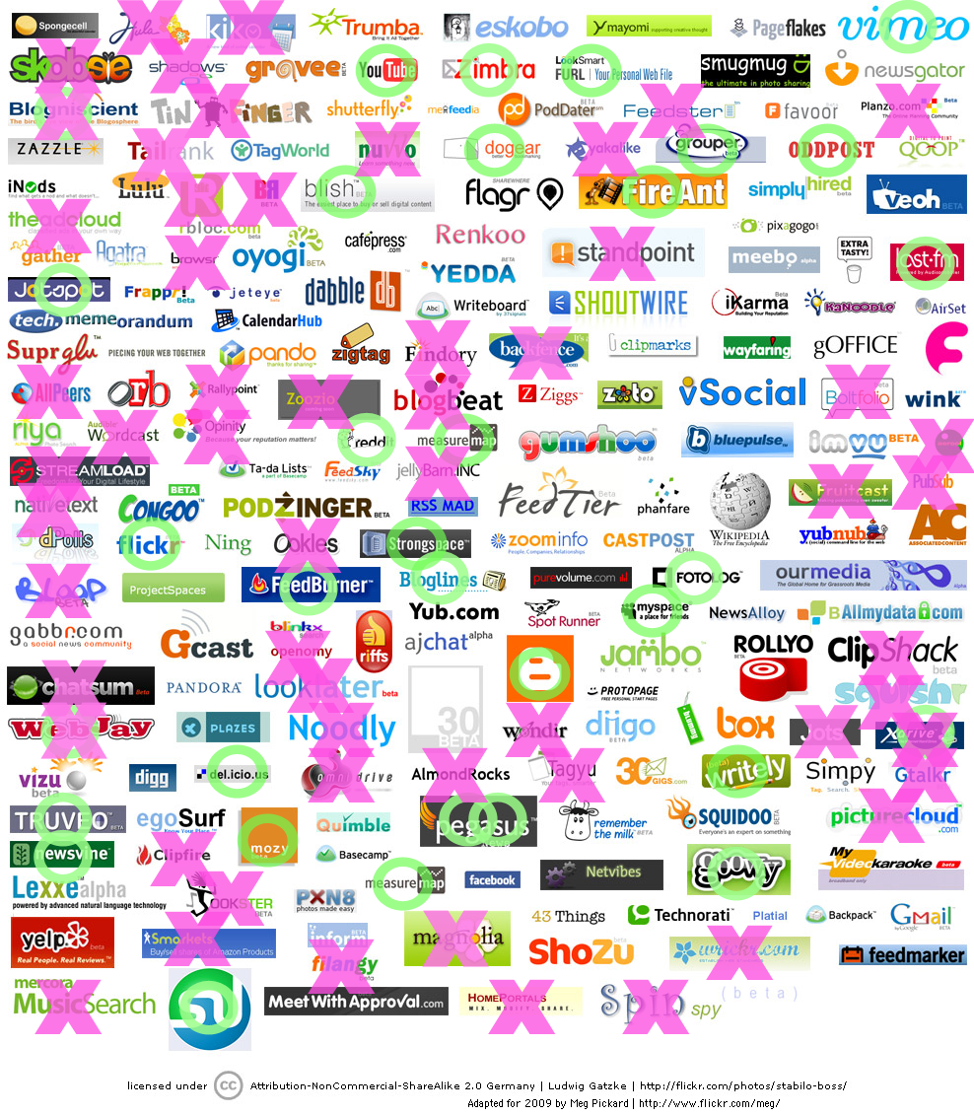
Most Startups Fail
Notes:
Hi, I’m Eric Ries. I wan to talk to you today about one simple fact: that the vast majority of high-tech startups fail.
It does not have to be that way.
Read the stories of successful startups and, if the founders are willing to be honest, you will see this pattern over and over again. They started out as digital cash for PDAs, but evolved into online payments for eBay. They started building BASIC interpreters, but evolved into the world's largest operating systems monopoly. They were shocked to discover their online games company was actually a photo-sharing site.
Each of these companies were fortunate to have enough time, resources, and patience to endure the multiple iterations it took to find a successful product and market. The premise of the lean startup is simple: if we can reduce the time between these major iterations, we can increase the odds of success.

Slide 5
What is a startup?
A startup is a human institution designed to deliver a new product or service under conditions of extreme uncertainty.
Nothing to do with size of company, sector of the economy, or industry

Slide 6
What is a startup?
STARTUP
=
EXPERIMENT

Slide 7
Understanding Failure
Not because the technology doesn’t work
No customers or a sustainable business model
With better management, idea failure doesn’t have to lead to company failure

Slide 8
The Pivot
What do successful startups have in common?
  They started out as digital cash for PDAs, but evolved into online payments for eBay.
  They started building BASIC interpreters, but evolved into the world's largest operating systems monopoly.
  They were shocked to discover their online games company was actually a photo-sharing site.
Pivot: change directions but stay grounded in what we’ve learned.
http://startuplessonslearned.blogspot.com/2009/06/pivot-dont-jump-to-new-vision.html
Notes:
The premise of the lean startup is simple: if we can reduce the time between these major iterations, we can increase the odds of success.

Slide 9
Speed Wins
If we can reduce the time between pivots
We can increase our odds of success
Before we run out of money

Slide 10
Lean startups go faster
Commodity technology stack, highly leveraged (open source, user-generated content, SEM).
Customer development – find out what customers want before you build it.
Product development principles drawn from Lean Manufacturing & Agile.
Notes:
Based on that experience, and the experience of the other startups I have worked for, I now strongly believe there is a better way to create startups. I’ve called this vision the Lean Startup. It combines three key trends.

Slide 11
Platforms enable leverage
Leverage = for each ounce of effort you invest in your product, you take advantage of the efforts of thousands or millions of others.
It’s easy to see how high-leverage technology is driving costs down.
More important is its impact on speed.
Time to bring a new product to market is falling rapidly.

Slide 12

Traditional Product Development
Unit of Progress: Advance to Next Stage
Waterfall
Requirements
Specification
Design
Problem: known
Solution: known
Implementation
Verification
Maintenance

Slide 13

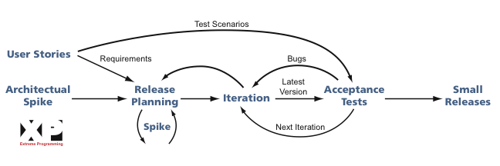
Agile Product Development
Unit of Progress: A line of Working Code
“Product Owner” or in-house customer
Problem: known
Solution: unknown

Slide 14
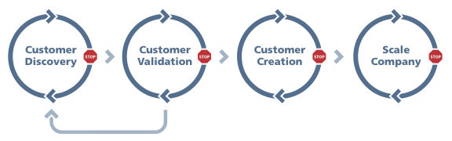

Product Development at Lean Startup
Unit of Progress: Validated Learning About Customers ($$$)
Customer Development
Hypotheses,
Experiments,
Insights
Problem: unknown
Data,
Feedback,
Insights
Solution: unknown
Notes:
What is progress? IMVU add-on story?

Slide 15

The Startup OODA Loop
IDEAS
IDEAS
LEARN
BUILD
DATA
DATA
PRODUCT
MEASURE
Minimize TOTAL time through the loop
Notes:
BUILT TO LEARN
This is the core feedback loop that powers startups. Their goal is not to optimize the time it takes to do any one of these steps.
There are many specific practices that can power lean startups, and we’ll cover a few in this presentation. But more important than any specific practice is this core idea: startups should be built to learn.

Slide 16
Doing More With Less
FASTER STARTUPS
=
MORE EXPERIMENTS PER DOLLAR

Slide 17
Government 2.0
Given the opportunity, what experiments would you like to run?
What if we could run them by the dozen?

Slide 18
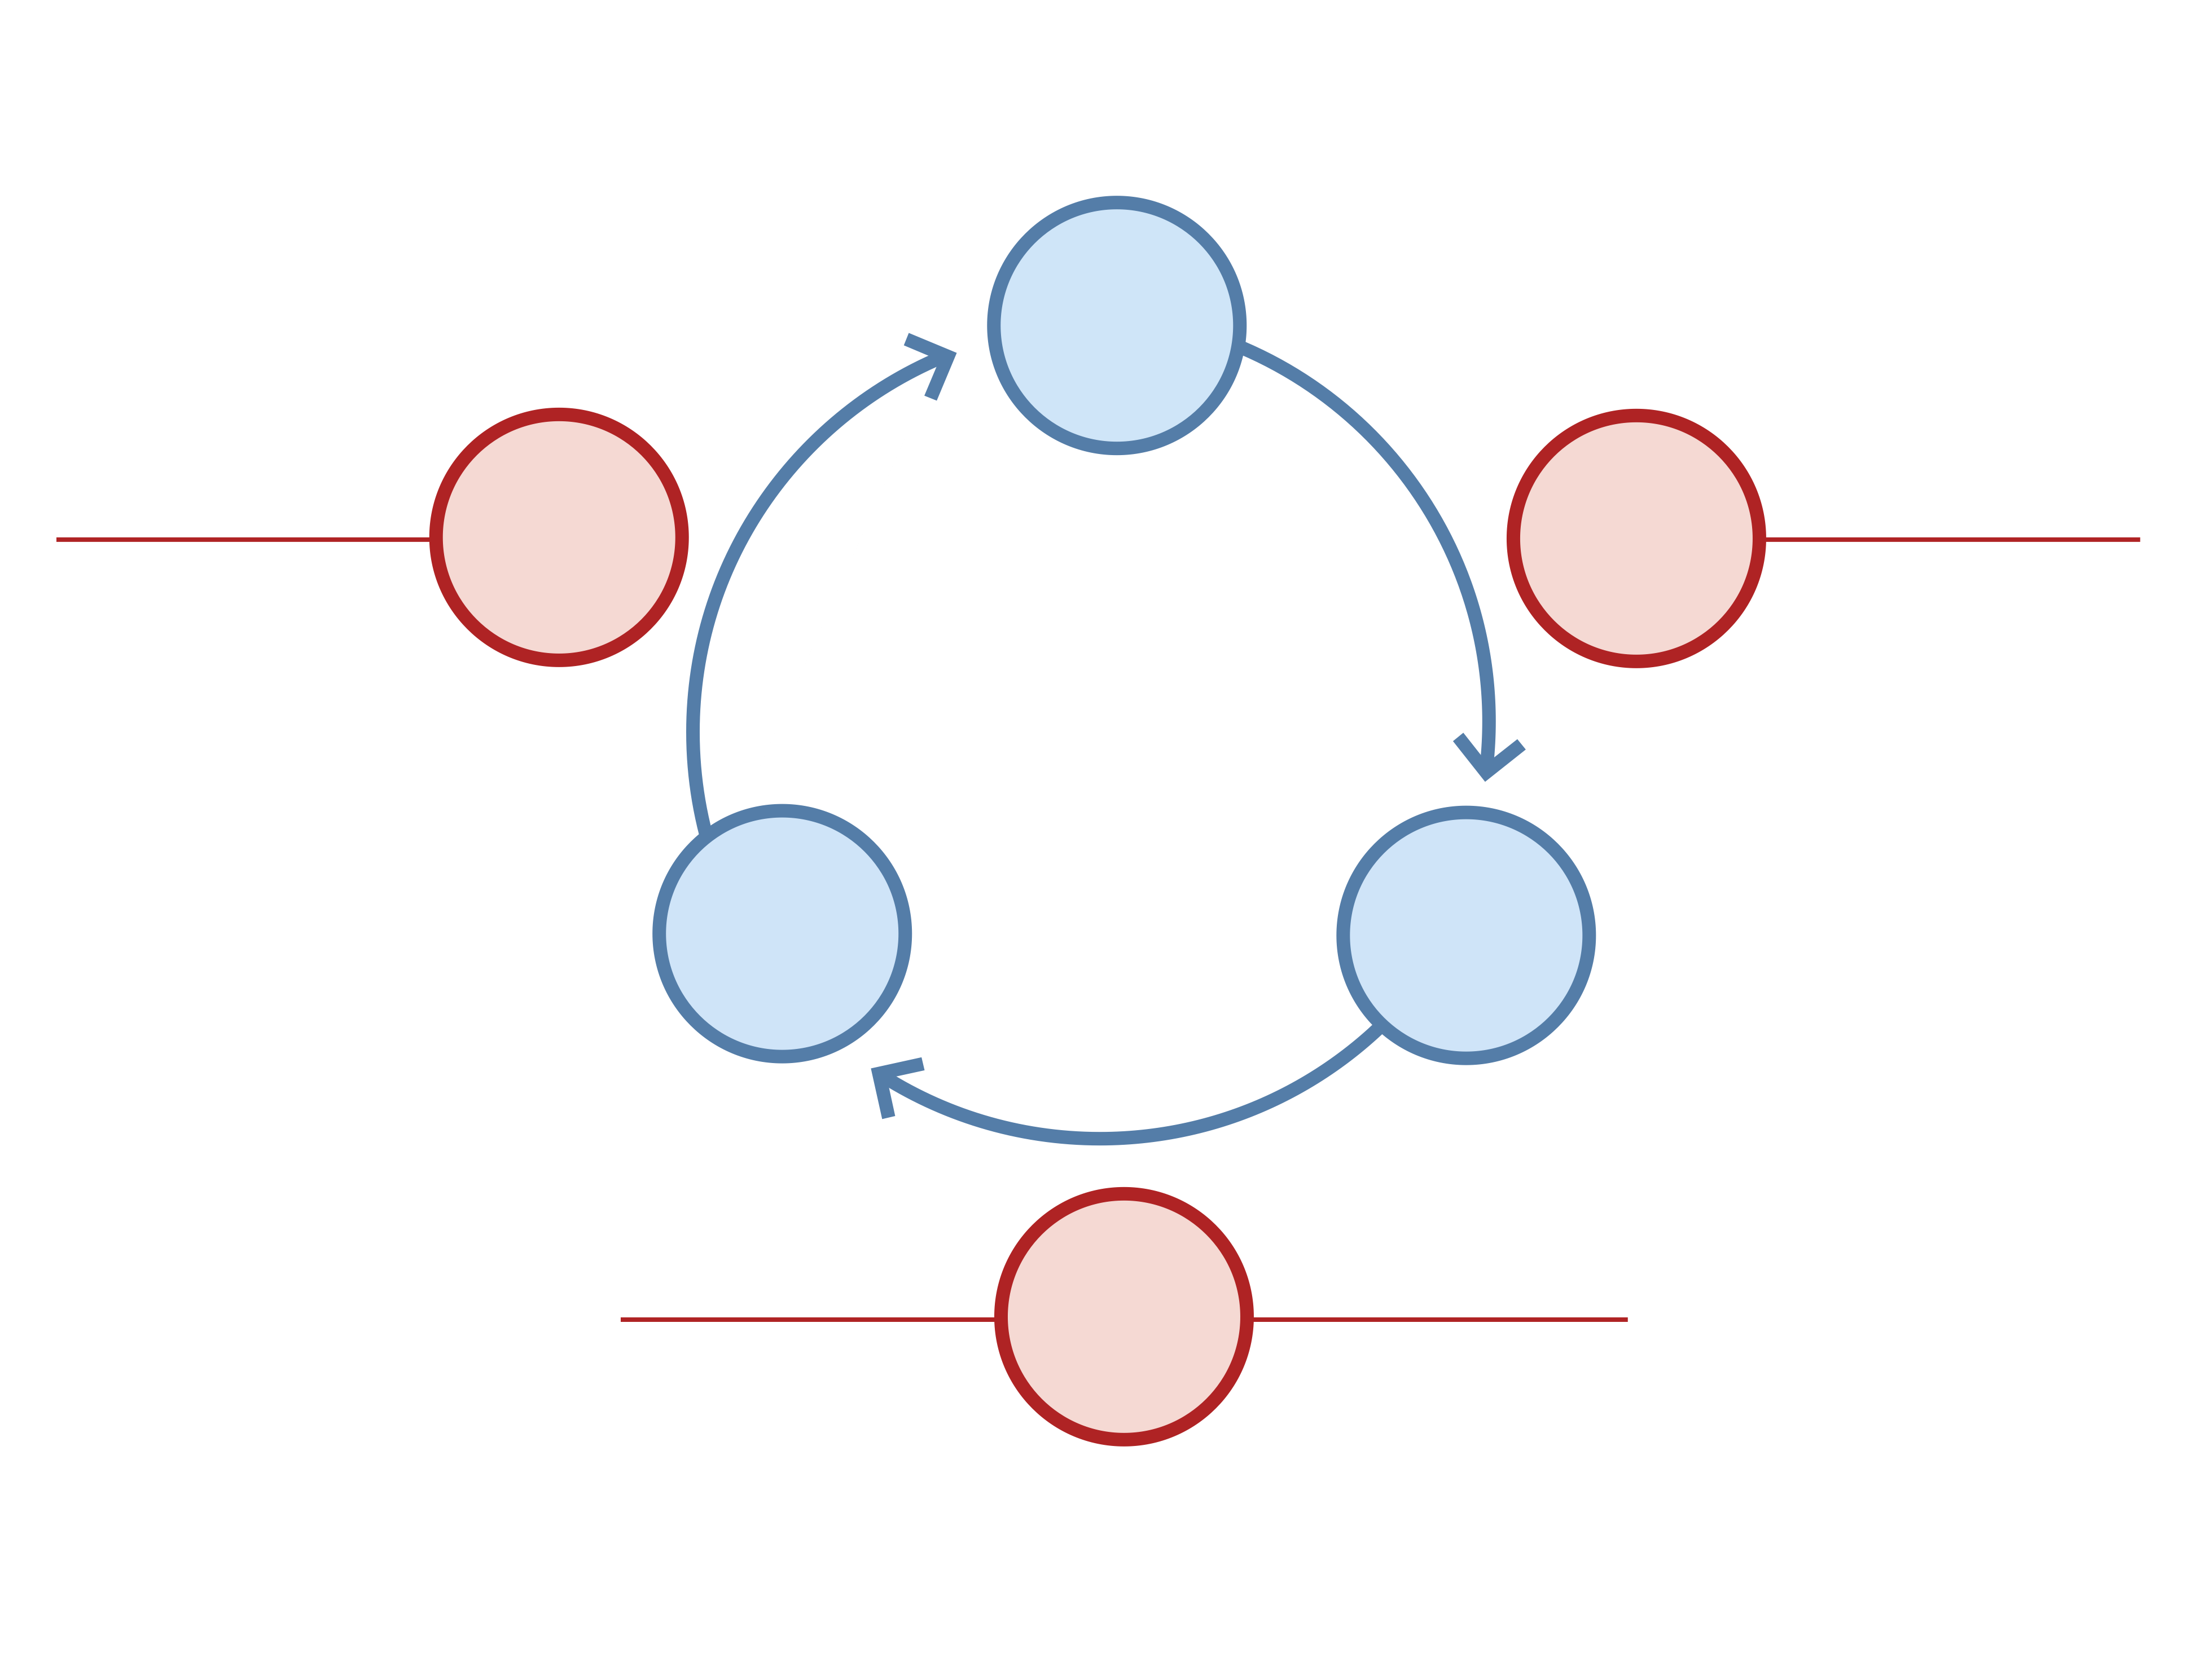
There’s much more…
IDEAS
Learn Faster
Code Faster
LEARN
BUILD
Split Tests
Customer Interviews
Customer Development
Five Whys Root Cause Analysis
Customer Advisory Board
Falsifiable Hypotheses
Product Owner Accountability
Customer Archetypes
Cross-functional Teams
Semi-autonomous Teams
Smoke Tests
Unit Tests
Usability Tests
Continuous Integration
Incremental Deployment
Free & Open-Source Components
Cloud Computing
Cluster Immune System
Just-in-time Scalability
Refactoring
Developer Sandbox
Minimum Viable Product
DATA
PRODUCT
Measure Faster
MEASURE
Split Tests
Clear Product Owner
Continuous Deployment
Usability Tests
Real-time Monitoring
Customer Liaison
Funnel Analysis
Cohort Analysis
Net Promoter Score
Search Engine Marketing
Real-Time Alerting
Predictive Monitoring
Notes:
Webcast: May 1
Workshop: May 29
Fliers up front
Discussion in web2open

Slide 19
Thanks!
Startup Lessons Learned Blog
  http://StartupLessonsLearned.blogspot.com/
Getting in touch
  http://twitter.com/ericries
  eric@theleanstartup.com
Other events
  Web 2.0 Expo NYC November 16-19
  O’Reilly Master Class NYC December 10
  Geeks on a Plane DC/EU September 18

